Slide 1
The Brown Act and You |
A College of the Sequoias Local Senate Visit
April 22, 2026
Notes:
MARK

Slide 2
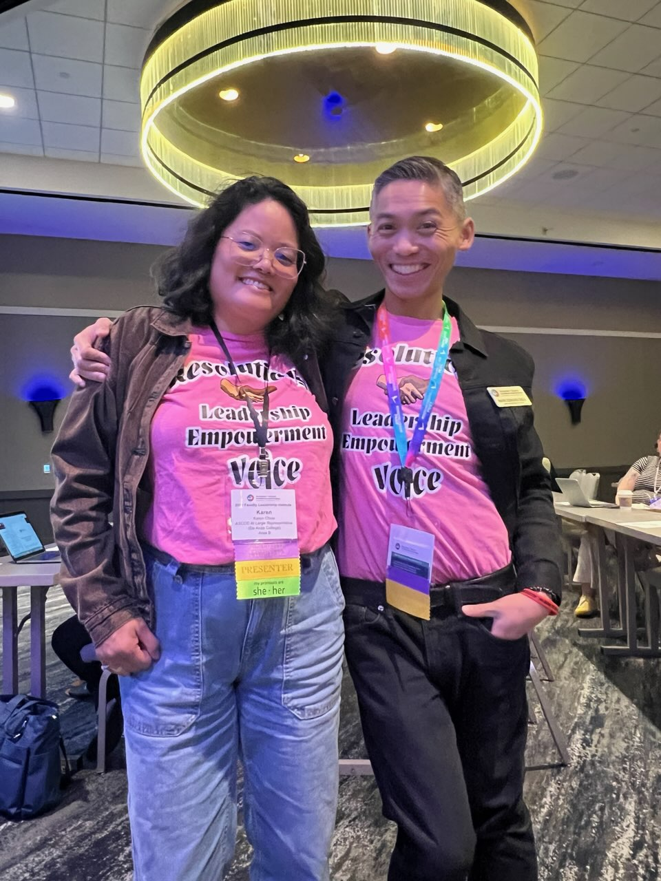
FACILITATORS |
Karen Chow
ASCCC At-Large Representative
De Anza College
Professor, English
Mark Edward Osea
ASCCC Area B Representative
Mendocino College
Articulation Office & Transfer Counselor
Notes:
BOTH

Slide 3
DISCLAIMER |
We're faculty colleagues sharing promising practices, not lawyers offering legal advice. When specific situations arise, please reach out to your legal counsel for guidance.

Slide 4
OUTLINE | What will be covered
Committee A’s Prioritized Questions
COMPLIANCE | Which campus bodies fall under the Brown Act? (What about the Senate Exec Board?)
AGENDAS | Do agendas/documents have to adhere to any accessibility standards? Do they need to be offered in alternate formats?
POSTING | What reporting or posting requirements might apply (for committees/subcommittees)?
Notes:
Karen slides 4-12

Slide 5
OUTLINE | What will be covered (Con’t)
Committee A’s Prioritized Questions
VOTING | What rules govern voting procedures? (When is roll call required?)
ELECTRONIC VOTING | What guidelines should we follow for voting electronically?
INFORMATION | How should committees handle drafts or background materials?
PUBLIC COMMENT | What guidelines does a committee need to follow during public comments?
Notes:
Karen

Slide 6
QUESTION | Compliance
Which campus bodies fall under the Brown Act? (What about the Senate Exec Board?)
Notes:
Karen

Slide 7
The Brown Act |
The Premise
Notes:
Karen

Slide 8
Government Code (GC) §54950 |
“Declaration of Intent”
In enacting this chapter, the Legislature finds and declares that the public commissions, boards and councils and the other public agencies in this State exist to aid in the conduct of the people’s business. It is the intent of the law that their actions be taken openly and that their deliberations be conducted openly. The people of this State do not yield their sovereignty to the agencies which serve them. The people, in delegating authority, do not give their public servants the right to decide what is good for the people to know and what is not good for them to know. The people insist on remaining informed so that they may retain control over the instruments they have created.

Slide 9
GC §§54951-54952 |
Local Agencies and Legislative Bodies

Slide 10
§54951 |
“As used in this chapter, “local agency” means a county, city, whether general law or chartered, city and county, town, school district, municipal corporation, district, political subdivision, or any board, commission or agency thereof, or other local public agency.”
Local Agency Defined

Slide 11
§54952 | Legislative Body Defined
As used in this chapter, “legislative body” means:
The governing body of a local agency or any other local body created by state or federal statute.
A commission, committee, board, or other body of a local agency, whether permanent or temporary, decisionmaking or advisory, created by charter, ordinance, resolution, or formal action of a legislative body. However, advisory committees, composed solely of the members of the legislative body that are less than a quorum of the legislative body are not legislative bodies, except that standing committees of a legislative body, irrespective of their composition, which have a continuing subject matter jurisdiction, or a meeting schedule fixed by charter, ordinance, resolution, or formal action of a legislative body are legislative bodies for purposes of this chapter.

Slide 12
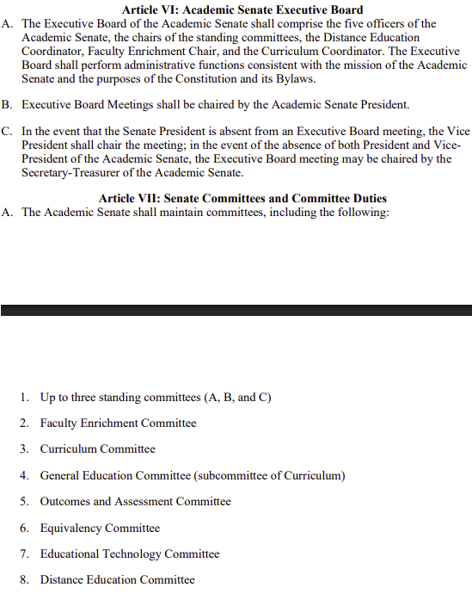
Promising Practice | Academic Senate Committees
BYLAWS | What are in the bylaws or constitution?

Slide 13
QUESTIONS | All Things Agenda
Do agendas/documents have to adhere to any accessibility standards? Do they need to be offered in alternate formats?
What reporting or posting requirements might apply (for committees/subcommittees)?

Slide 14
GC §§54954-54954.2 |
Notice to the Public

Slide 15
§54954.2 | Meeting Agendas
(a)(1) | Agenda posted at least 72 hours prior to a regular meeting.
(a)(1)(A) | “…Agenda shall contain a brief general description of each item of business to be transacted or discussed…”
(a)(1)(B) | “…[agenda] shall be posted in a location that is freely accessible to member of the public and on the local agency’s internet website…”

Slide 16
§54954.2 | Meeting Agendas (con’t)
(a)(1)(C)(i) | “If requested, the agenda shall be made available in appropriate alternative formats to persons with a disability, as required by Section 202 of the Americans with Disabilities Act of 1990 (42 U.S.C. Sec. 12132), and the federal rules and regulations adopted in implementation thereof.”

Slide 17
§54953 |
(b)(3) | If body elects to teleconference, “it shall post agendas at all teleconference locations. Each teleconference location shall be identified in the notice and agenda of the meeting or proceeding, and each teleconference location shall be accessible to the public.”
Teleconference

Slide 18
SB 707 (Durazo, 2025) |
Meetings and Teleconference Requirements

Slide 19
§54953.4(e)(2) | “Eligible legislative bodies” that are subject to SB 707 include:
CITY | “A city council of a city with a population of 30,000 or more”
SUPERVISORS | “A county board of supervisors of a county, or city and county, with a population of 30,000 or more”
CITY | “City council of a city located in a county with a population of 600,000 or more”
SPECIAL DISTRICTS | “The board of directors of a special district that has an internet website and meets any of the following conditions:”
Boundary constraints, 600,000 population, over 200 FT equivalent employees
Over 1000 full-time equivalent employees
Revenues exceeding $400,000,000 and over 200 FT equivalent employees

Slide 20
QUESTIONS | Voting
What rules govern voting procedures? (When is roll call required?)
What guidelines should we follow for voting electronically?
Notes:
Karen 20-23

Slide 21
GC §§54953(d)(1) – 54953(d)(2) |
Voting Considerations
Notes:
Karen

Slide 22
§54953 |
(d)(1) | “No legislative body shall take action by secret ballot, whether preliminary or final.”
(d)(2) | “The legislative body of a local agency shall publicly report any action taken and the vote or abstention on that action of each member present for the action.”
Accountability
Notes:
Karen

Slide 23
§54953 | Teleconferencing
If a legislative body elects to allow for teleconferencing
  (b)(2)(A) | “All votes taken during a teleconferenced meeting shall be by rollcall.”
Notes:
Karen

Slide 24
QUESTION | Information
How should committees handle drafts or background materials?

Slide 25
GC §54952.2 |
Exceptions to Brown Act

Slide 26
§54952.2 | Exceptions
(b)(2) | “Paragraph (1) shall not be construed as preventing an employee or official of a local agency, from engaging in separate conversations or communications outside of a meeting … with members of a legislative body in order to answer questions or provide information regarding a matter that is within the subject matter jurisdiction…, if that person does not communicate to members of the legislative body the comments or position of any other member or members of the legislative body.”
(c)(1) | “Nothing in this section shall impose the requirements upon…individual contacts or conversations between a member of a legislative body and any other person that do not violate subdivision (b).

Slide 27
§54952.2 | Key Takeaways
CONSTITUENTS | Dialogues with constituents are allowed, if not expected, i.e. listening to concerns and matters of importance to a members constituents.
INFORMATION | It is okay to share information.
OPINION | Members’ opinions may be indicative of their vote on an agenda item.
SERIAL MEETING | If members are privy to opinions of other members, it may constitute a “serial meeting”.

Slide 28
Promising Practices | Information and Drafts
BCC | Use BCC to share information so as to minimize discussion outside of a regular meeting with other members of the legislative body.
AD HOC | Establish ad hoc committees with less than quorum of members of the Academic Senate to fully draft documents.

Slide 29
QUESTION | Public Participation
What guidelines does a committee need to follow during public comments?
Notes:
Karen 29-33

Slide 30
GC §54954.3 |
Opportunities for the Public to Address the Legislative Body
Notes:
Karen 29-33

Slide 31
§54954.3 | Public Participation
(a)(1) | “Every agenda for regular meetings shall provide an opportunity* for … the public to directly address the legislative body on any item of interest…, before or during the legislative body’s consideration of the item, that is within the subject matter jurisdiction of the legislative body, provided that no action shall be taken on any item not appearing on the agenda unless the action is otherwise authorized by subdivision (b) of Section 54954.2.”
Notes:
Karen
There are exceptions to this but under limited circumstances as outlined in §§54954.3(a)(2)(A) and 54954.3(a)(2)(B).

Slide 32
§54954.3 | Guidelines for Public Participation
(b)(1) | “The legislative body of a local agency may adopt reasonable regulations to ensure that the intent of subdivision (a) is carried out, including, but not limited to, regulations limiting the total amount of time allocated for public testimony on particular issues and for each individual speaker.”
  TIME ALLOTED | Total of 15 minutes for public comment.
  SPEAKER LIMIT | No more than 3 minutes per speaker.
Notes:
Karen

Slide 33
§54954.3 | Guidelines for Public Participation (Con’t)
(c) | “The legislative body of a local agency shall not prohibit public criticism of the policies, procedures, programs, or services of the agency, or of the acts or omissions of the legislative body. Nothing in this subdivision shall confer any privilege or protection for expression beyond that otherwise provided by law.”
Notes:
Karen

Slide 34
GC §54954.2(a)(2) |
Responding to Public Comments

Slide 35
§ 54954.2(a)(2) | Responding to the Public
(E)(3) | As a response to public comment:
  A member of the legislative body or their staff may ask for clarification
  “May provide a reference to staff or other resources for factual information”
  “Request staff to report back to the body at a subsequent meeting…concerning any matter”
  “Direct staff to place a matter of business on a future agenda”
(E)(3) | “On [a member’s] own initiative”, a member of the legislative body may:
  “Make a brief announcement”
  “Make a brief report on their own activities.”

Slide 36
The Public | Statutes about Public Participation
§54957.9 | Disorderly conduct of the general public during meeting
§54957.95 | Removal of disruptive (in-person) individual during meeting
§54957.96 | Removal of disruptive (participating remotely) individual during meeting
§54953.5 | Recording meetings

Slide 37
Resources |
STATUTES | The Ralph M. Brown Act and Related Statutes (updated January 2026)
GUIDE | Open & Public VI: A Guide to the Ralph M. Brown Act (Revised January 2024)
WEBSITE | A Guide to SB 707 (Durazo, 2025)
OPINION | California Attorney General Opinion about the Applicability of the Brown Act to Academic Senates
GUIDE | A Public Official's Guide to the Brown Act (January 2022)
Brown Act

Slide 38

Resources | ASCCC
EMAIL | info@asccc.org
WEBSITE | ASCCC Home Page
LOCAL VISIT | Request a local senate visit
LISTSERV | Join an ASCCC listserv to stay up-to-date on ASCCC information and opportunities. Some listservs include:
Area, Senate President, Curriculum, President’s Update, CPL Info (new!)
Notes:
Karen

Slide 39
Questions?
Thoughts?
Concerns?
Notes:
Karen

